Slide 1

MACHINE LEARNING PROJECT
Energy Consumption
Forecasting
UCI Household Electric Power Consumption Dataset
Short-Term Prediction
Time Series Analysis
Ensemble Methods
Team Members
Date
Manan Velani (U23CS027) Dharav Bodat (U23CS049) Nikhil Chhasiya (U23CS022) Om Amin (U23CS076)
April 2026

Slide 2
PROBLEM STATEMENT
What We're Solving & Why
The Challenge
Three-Layer Approach
Household energy consumption is highly variable and influenced by multiple factors including time of day, seasonality, and appliance usage patterns. Accurate short-term forecasting is critical for:
01
Data Preprocessing Pipeline
Production-grade pipeline: ingestion → physical validation → hierarchical imputation → cyclical & lag feature engineering → differential scaling
Grid Optimization: Balancing supply and demand in real-time
Cost Reduction: Enabling dynamic pricing and load shifting
Energy Management: Empowering consumers with usage insights
02
Exploratory Data Analysis
Comprehensive analysis: time-series structure, seasonality decomposition, stationarity tests, correlation analysis, outlier detection, anomaly identification
Our Objective
Build a production-grade forecasting system that preprocesses raw sensor data, extracts meaningful patterns through comprehensive EDA, and compares multiple ML algorithms to identify the best predictive model for household energy consumption.
ML Forecasting Module
03
Comparative modeling: Linear Regression (baseline), Decision Tree (interpretability), Random Forest (ensemble performance) with engineered features
Key Innovation: Hierarchical imputation using seasonal means and cyclical time encodings capture complex temporal patterns

Slide 3
DATA OVERVIEW
Dataset Description
UCI Repository Dataset
Features & Target Variable
Source File
household_power_consumption.txt
Global_active_power
TARGET
Separator
Semicolon (;)
Household global minute-averaged active power (kilowatts)
Missing Values
Encoded as '?' (~1.25%)
Global_reactive_power
Voltage
Reactive power (kW)
Minute-averaged voltage (V)
Granularity
1-minute intervals
Global_intensity
Sub_metering_1
Time Range
Multi-year recording
Current intensity (A)
Kitchen (Wh)
Dataset Size Used
50,000 rows (of ~2M)
Sub_metering_2
Sub_metering_3
Laundry (Wh)
Water heater/AC (Wh)
Note: Full dataset contains ~2 million rows. Subset used for computational efficiency in Colab environment while maintaining representative temporal patterns.
Derived Feature
E_rem (Remainder Energy): Global_active_power × (1000/60) − Sub_metering_1 − Sub_metering_2 − Sub_metering_3

Slide 4
PREPROCESSING
Data Preprocessing Pipeline
Physical Validation
Hierarchical Imputation
Feature Engineering
Negative active power → NaN
Short gaps (<30 min): Cubic interpolation
Cyclical: sin/cos encodings (hour, month, weekday, minute)
Voltage outside 220-255V → NaN
Long gaps (≥30 min): Seasonal means (hour, weekday)
Compute E_rem remainder energy
Lag features: 1, 60, 1440 min
Final: ffill() → bfill()
Rolling: 60-min & 1440-min mean/std
Pipeline Architecture
Scaling Strategy
Raw Data
PhysicalValidator
Power columns
MinMaxScaler
HierarchicalImputer
CyclicalEncoder
Voltage columns
StandardScaler
Cyclical & other
Pass-through
LagAndRollingFeatureEngineer
DataFrameScaler
FinalNaNGuard
Clean (X_train, X_test)
Anti-Leakage Measures
80/20 chronological split (no shuffling)
Pipeline fit on training only
Test data: transform only
Rolling features shifted by 1

Slide 5
EXPLORATORY DATA ANALYSIS
Key Findings & Insights
Time Series Structure
Correlation Analysis
1-min
1.25%
Global_active_power ↔ Global_intensity
~1.0
Granularity
Missing Values
Nearly perfect correlation (I = P/V)
Data resampled to hourly, daily, and weekly aggregations for visualization. Missing timestamps identified by comparing actual vs. expected full date range.
Global_active_power ↔ Voltage
Weak -
Target Distribution
Weak negative correlation
Global_active_power shows positive skew: many low-consumption periods with fewer extreme peaks.
Action: Global_intensity dropped from forecasting to avoid multicollinearity
Skewness
Pattern
Positive
Right-tail
Stationarity Tests
ADF Test
KPSS Test
Seasonality Analysis
p < 0.05
Passed
Daily seasonality confirmed: ACF/PACF peaks at lags 24 and 48
Stationary ✓
Confirmed ✓
Weekly pattern observed: Lag 168 (1 week) strong autocorrelation
Additive decomposition (period=7 days) on daily data
Anomaly Detection
Isolation Forest (contamination=0.01) on daily data identifies anomalous days. Energy "outliers" may be valid high-load events (AC/heaters) requiring domain knowledge.

Slide 6
METHODOLOGY
Model Architecture & Workflow
Linear Regression
Decision Tree
Random Forest
Baseline Model
Interpretable Model
Ensemble Model ★
Library
sklearn.linear_model
max_depth
6
n_estimators
20
Type
LinearRegression
random_state
42
max_depth
8
Purpose
Baseline
Purpose
Interpretability
n_jobs
-1 (all cores)
Simple, interpretable baseline for comparison
Captures non-linear relationships, easy to explain
Purpose
Best Performance
Expected winner: Ensemble + engineered features
Feature Set for ML Module
End-to-End Workflow
Temporal
Calendar
1
Raw Sensor Data (UCI Dataset)
hour, dayofweek, month
dayofmonth, is_weekend
Lag Features
Rolling
2
Preprocessing Pipeline (Validation → Imputation)
lag_1, lag_2
rolling_mean_10
Electrical
Sub-metering
3
Feature Engineering (Cyclical + Lag + Rolling)
Voltage, Global_intensity
Sub_metering_1/2/3
4
Model Training (3 algorithms compared)
5
Evaluation (MAE, RMSE metrics)

Slide 7
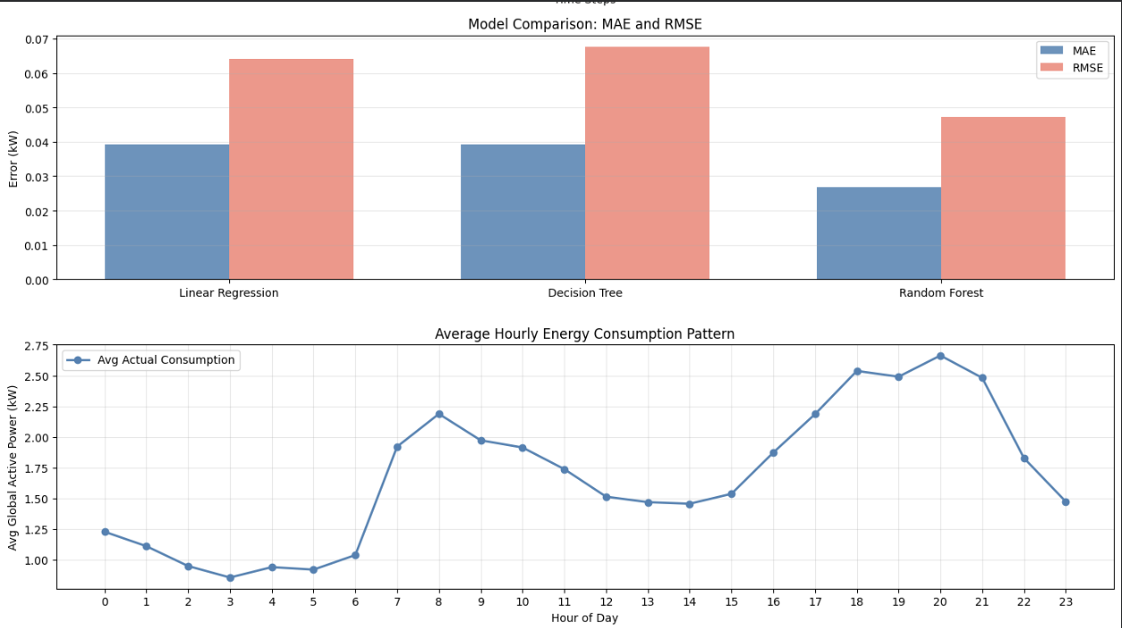
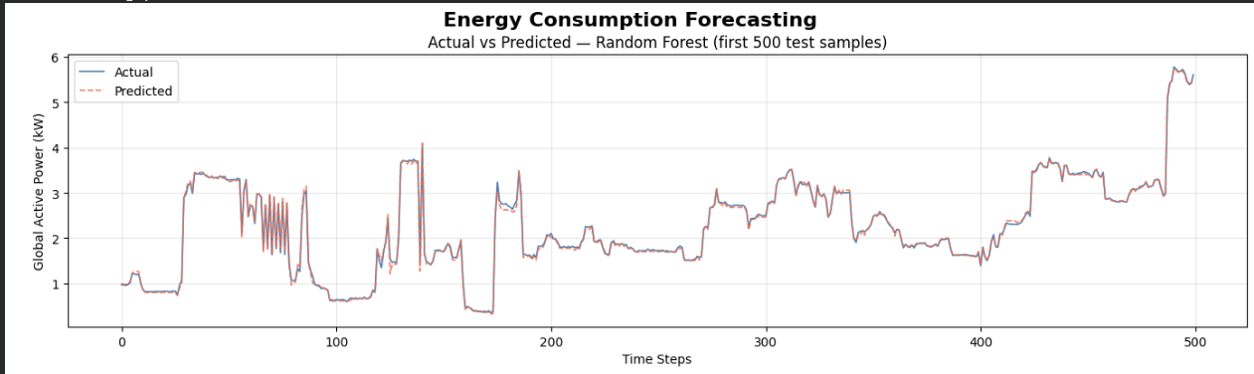
RESULTS
Model Performance Comparison
Performance Metrics
Model Comparison Chart
Linear Regression
Baseline
MAE
RMSE
~0.040
~0.065
Decision Tree
Interpretable
MAE
RMSE
~0.040
~0.068
Random Forest ★
BEST
MAE
RMSE
MAE and RMSE comparison across all three models
~0.027
~0.048
Actual vs Predicted
Key Results
Random Forest wins with 30-40% lower RMSE
Best model selected by lowest RMSE criterion
All metrics in kW (same unit as target)
Random Forest predictions on first 500 test samples

Slide 8
FEATURE ANALYSIS
Feature Importance & Insights
Random Forest Feature Rankings
Key Insights
lag_1 & lag_2
HIGHEST
Recent History Dominates
Most recent consumption readings (1-2 min ago) are the strongest predictors
Lag features (lag_1, lag_2) rank highest, confirming that recent consumption is the strongest signal for short-term forecasting.
rolling_mean_10
HIGH
Trend Matters
Short-term trend (10-reading rolling mean) captures momentum
Rolling_mean_10 is highly predictive, showing that short-term momentum (increasing/decreasing trends) provides valuable information.
Global_intensity
MEDIUM
Electrical Features Contribute
Current intensity highly correlated with power (I = P/V)
Global_intensity and Voltage are significant predictors, though intensity is redundant (perfectly collinear with target).
Voltage
MEDIUM
Voltage fluctuations influence power consumption patterns
Temporal Features Help
Time features (hour, dayofweek) rank lower but still contribute, capturing daily and weekly consumption patterns.
Sub_metering_3
MEDIUM
Water heaters and AC units are high-draw appliances
EDA Confirmation: Separate Random Forest (50 estimators, 50K samples) produces consistent rankings, excluding Global_intensity due to perfect collinearity.

Slide 9
CHALLENGES & FUTURE WORK
Limitations & Improvements
Challenges Faced
Future Improvements
01
Dataset Size Constraints
Full Dataset Utilization
Limited to 50,000 rows (of ~2 million total) for Colab execution speed. Computational constraints prevented using the full dataset.
Scale to full 2 million rows using distributed computing (Spark/Dask) or cloud infrastructure for more robust training.
02
Perfect Collinearity
Deep Learning Models
Global_intensity is perfectly collinear with Global_active_power (I = P/V). Must be carefully handled to avoid multicollinearity in linear models.
Implement LSTM, GRU, or Transformer architectures to capture long-term dependencies and complex temporal patterns.
03
Simultaneous Missing Values
External Data Integration
Missing values occur simultaneously across all sensors, indicating sensor downtime (not random dropout), requiring hierarchical imputation strategies.
Incorporate weather data (temperature, humidity) and holiday calendars to improve prediction accuracy.
04
Valid High-Load Events
Hierarchical Forecasting
Energy "outliers" (IQR/Z-score) may be valid high-load events (AC/heaters). Domain knowledge required before capping or removing.
Explore hierarchical forecasting for sub-metering levels (kitchen, laundry, water heater) for granular insights.
05
Multiple Seasonalities
Multi-Horizon Prediction
Strong multiple seasonalities (daily and yearly) complicate stationarity assessment and require careful handling for modeling.
Extend to multi-step ahead forecasting (15-min, 1-hour, 1-day) for practical energy management applications.
Key Takeaway: Despite limitations, the current pipeline demonstrates strong performance and provides a solid foundation for production deployment.

Slide 10

CONCLUSION
Key Takeaways & Deliverables
Production Pipeline
EDA Insights
Forecasting Results
Modular Architecture
Peak Hours
Best Model
sklearn-compatible UCIPreprocessor with 5 sequential steps
Highest consumption: 18:00-21:00 (evening)
Random Forest outperforms Linear Regression and Decision Tree
Physical Validation
Seasonal Patterns
Performance
Negative power and voltage outliers flagged as NaN
Winter months show highest usage; weekends higher daytime load
30-40% lower RMSE compared to baseline models
Hierarchical Imputation
Redundancy
Top Predictors
Cubic interpolation + seasonal means + ffill/bfill
Global_intensity is redundant (perfectly collinear with target)
lag_1, lag_2, rolling_mean_10 (recent history dominates)
Feature Engineering
Stationarity
Key Insight
Cyclical encodings + lag features + rolling statistics
Data is stationary (ADF p<0.05) with strong daily/weekly seasonality
Recent consumption is the strongest signal for short-term energy forecasting
Output
Key Lags
Clean (X_train, X_test) with zero NaNs
Lag 24 (1 day) and Lag 168 (1 week) strongest autocorrelations
Practical Impact
Enables real-time energy management, grid optimization, and cost reduction
Project Success
Best Model RMSE
Three complete, layered deliverables demonstrating end-to-end ML pipeline from raw data to production-ready forecasting
~0.048 kW

